Slide 1
Establishing the Correlation Between Bio-Data and Concentration Level Utilizing EEG Data
Team HoT
Byeongsoo Min, Jeongmin Seo, Seojeong Park, Seungah Jang, Yunhui Lim, and
Martin Kim

Slide 2






Team members
Byeongsoo Min
min121@purdue.edu
Jeongmin Seo
seo140@purdue.edu
Seojeong Park
park1725@purdue.edu
Seungah Jang
jang240@purdue.edu
Yunhui Lim
lim440@purdue.edu
Martin Kim
kim3540@purdue.edu

Slide 3
Agenda
1
Introduction
2
Literature Reviews
3
Methodology
4
Implementation
5
Conclusion

Slide 4




Introduction
Background of Study
In modern society, a significant decline in concentration has become a major concern.
Therefore, we focused on analyzing concentration.

Slide 5
Introduction
Purpose and Brief Process
Purpose
Evaluate the correlation between bio-data and concentration
Process
1. Found out the correlation between EEG and concentration
2. Analyzed the correlation between bio-data and EEG
3. Predicted the concentration score using the correlation between bio-data and concentration

Slide 6
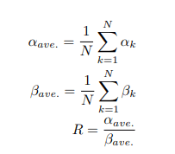
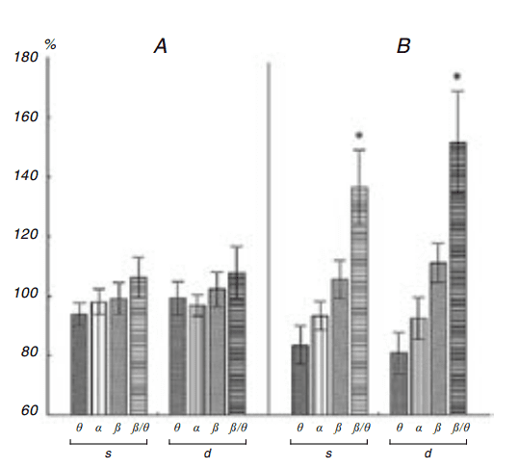
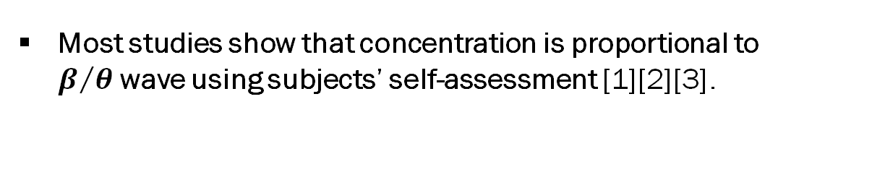
Literature Reviews
EEG
Bio-Data
Concent-ration
1. The Correlation Between EEG and Concentration
Most studies show that concentration is proportional to $β/θ$wave using subjects’ self-assessment [1][2][3].
In addition, there are two objective concentration criteria :
R index
β/θ Spectral Powers
Fig. 1. R index deprived from the alpha/beta ratio [4]
Fig. 2. Diagrams of the power of the EEG rhythms [5]

Slide 7
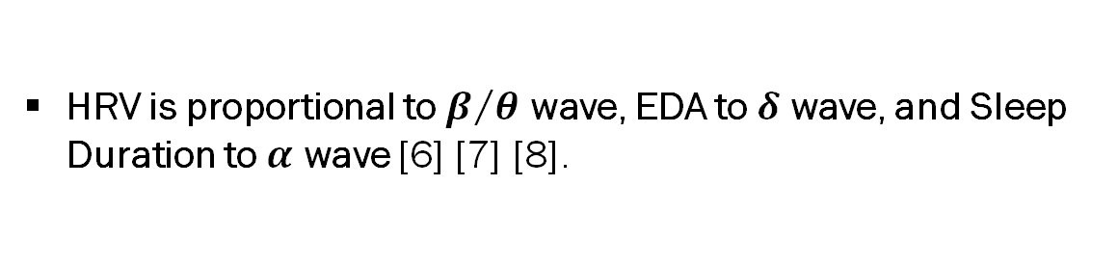



Literature Reviews
EEG
Bio-Data
Concent-ration
2. The Correlation Between Bio-data and EEG
HRV is proportional to $β/θ$ wave, EDA to $δ$ wave, and Sleep Duration to $α$ wave [6] [7] [8].
$$\text{HRV} \text{∝} \text{β}\text{/}\text{θ}$$
EDA $\text{∝} \text{δ}$
S$l\text{eep} \text{Duration} \text{∝} \text{α}$
Notes:
The Relationship Between Heart Rate Variability and Electroencephalography Functional Connectivity Variability Is Associated With Cognitive Flexibility [9]
Driver Attention Assessment Using Physiological Measures from EEG, ECG, and EDA Signals [10]
The Cumulative Cost of Additional Wakefulness: Dose-Response Effects on Neurobehavioral Functions and Sleep Physiology From Chronic Sleep Restriction and Total Sleep Deprivation [11]

Slide 8



Literature Reviews
EEG
Bio-Data
Concent-ration
3. The Correlation Between Bio-data and Concentration
Concentration is related to HRV, EDA, and Sleep Duration [9] [10] [11].
HRV $↔ \text{Concentration}$
EDA $↔\text{Concentration}$
Sleep Duration $↔\text{Concentration}$
Notes:
The Relationship Between Heart Rate Variability and Electroencephalography Functional Connectivity Variability Is Associated With Cognitive Flexibility [9]
Driver Attention Assessment Using Physiological Measures from EEG, ECG, and EDA Signals [10]
The Cumulative Cost of Additional Wakefulness: Dose-Response Effects on Neurobehavioral Functions and Sleep Physiology From Chronic Sleep Restriction and Total Sleep Deprivation [11]

Slide 9
Literature Reviews
Novelty
Tool
Adopting a wearable device in daily life
Method
Using a direct indicator of concentration
Result
Using quantified figures instead of subjective self-assessment
The correlation is provided with importance and proportionality

Slide 10
Methodology
Agenda of Methodology
1
Data Preprocessing
1
Data Collection
2
Data Preprocessing
2
Machine Learning Models
1
Model Selection
2
Model Training

Slide 11
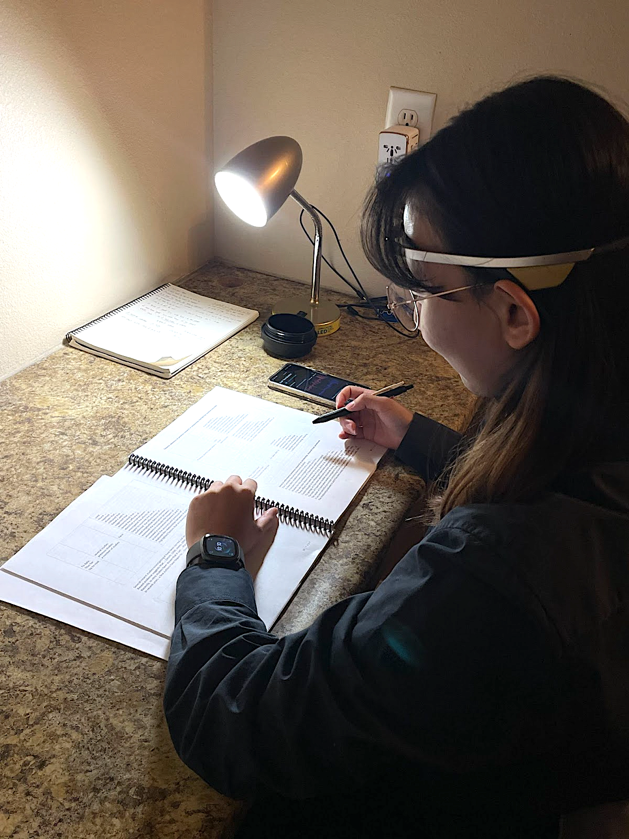
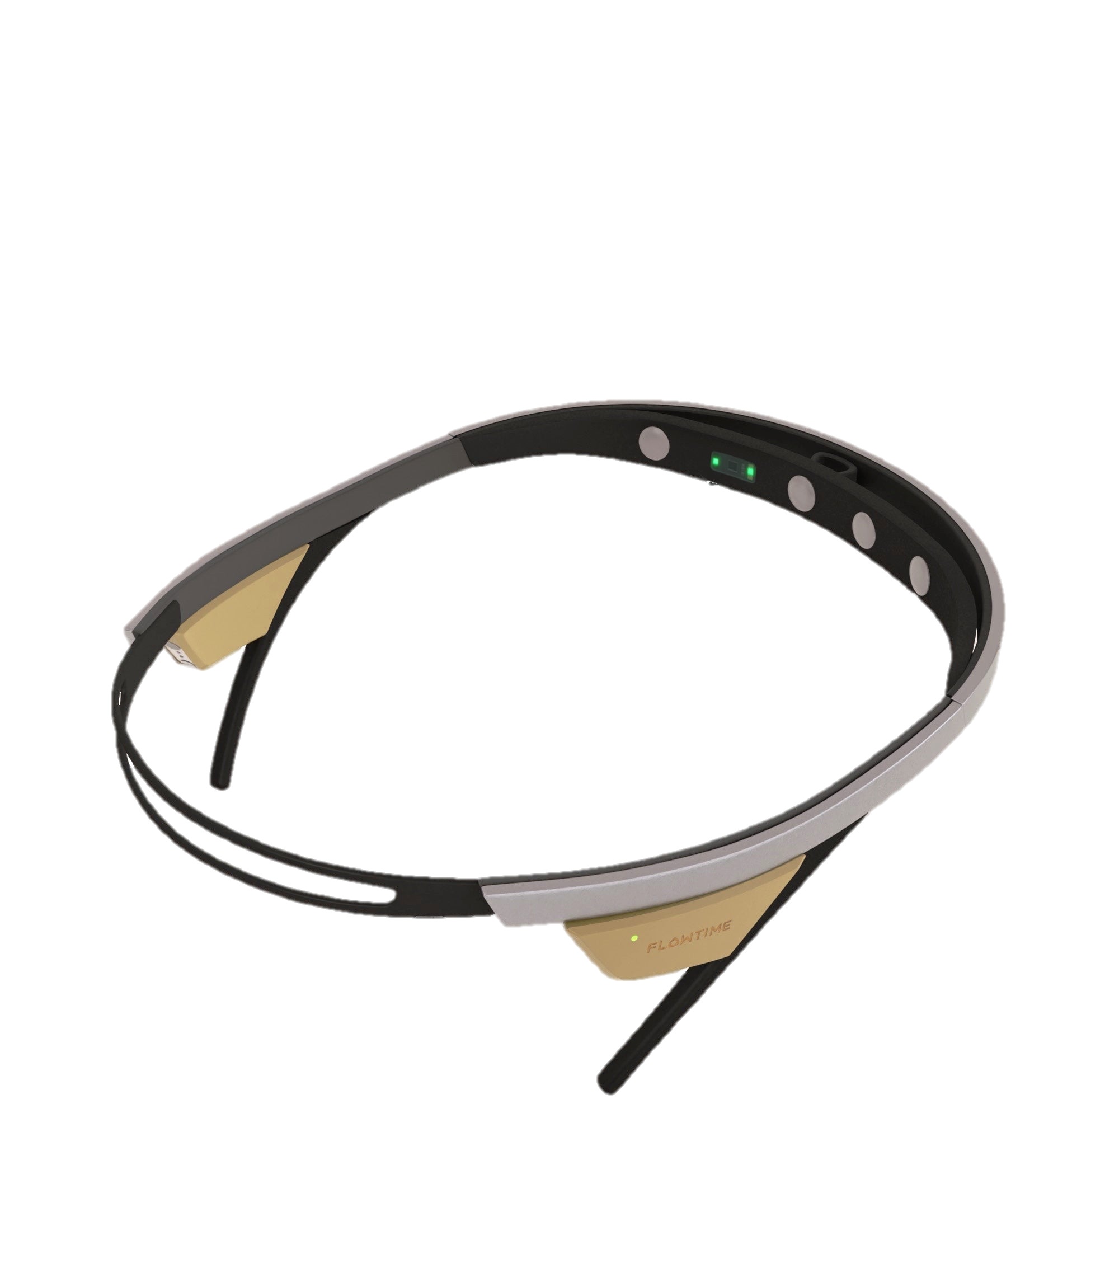
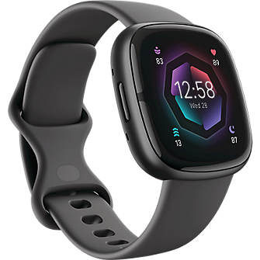
Methodology
Data Collection
Experimental Condition
6 subjects, 6 tests a day, 20 minutes experiment, 8 weeks
Wearing EEG sensor & wearable device simultaneously
Wearable device : Fitbit sense 2
EEG sensor : Flowtime Biosensing Meditation Headband

Slide 12
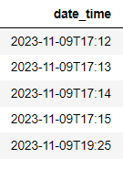
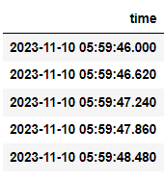
Methodology
Data Collection
Merging Fitbit data and EEG data
Different time formats and time intervals
Fitbit (1 min data)
Linear Interpolation
EEG (0.6 sec data)
Group mean

Slide 13
Methodology
Data Preprocessing
Stages
Selecting Concentration Indicator
Augmentation
Removing Error
Feature Engineering
Imputation
Feature Scaling
Feature Selection

Slide 14
Methodology
Data Preprocessing
Selecting Concentration Indicator
Comparison of Pearson Correlation with attention score
β/θ Spectral Powers (SP)
Versus
Reverse R index
Pearson Correlation | β/θ Spectral Powers | Reverse R index
attention score | 0.750154160664315 | 0.7205323406010573

Slide 15
Methodology
Data Preprocessing
Augmentation
In order to avoid making distortion in bio-data, we decided to augment by adjusting time interval
Fitbit : Dividing with Linear Interpolation
EEG : Grouping and Removing error value in group
Replacing with representative mean value
Time interval | N of row | R² score
10s split | 5763 | 0.8642836913
12s split | 4798 | 0.8557038406288009
15s split | 3825 | 0.8283565023468882
20s split | 2867 | 0.7817081703540152

Slide 16
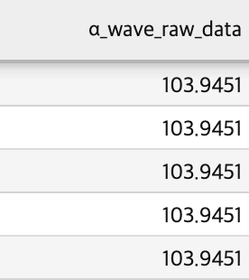
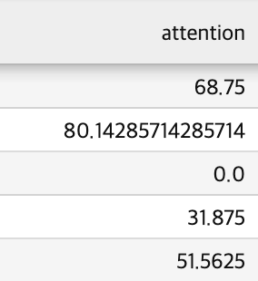
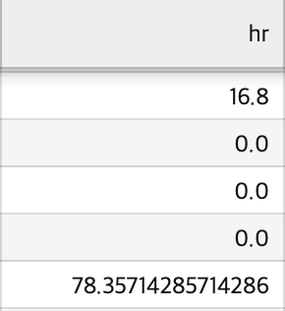
Methodology
Data Preprocessing
Removing Errors
Case 1 : A series of brain wave values that are the same as the initial value
Case 2 : attention score ‘0’
Case 3 : HR value ‘0’
Case 1
Case 2
Case 3

Slide 17
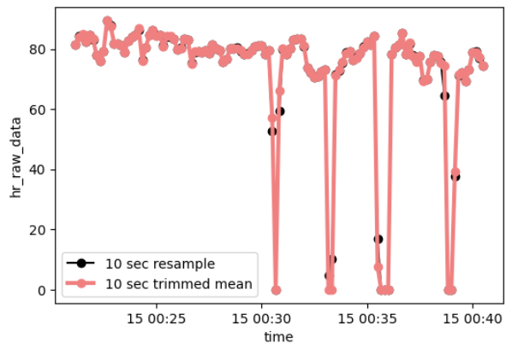
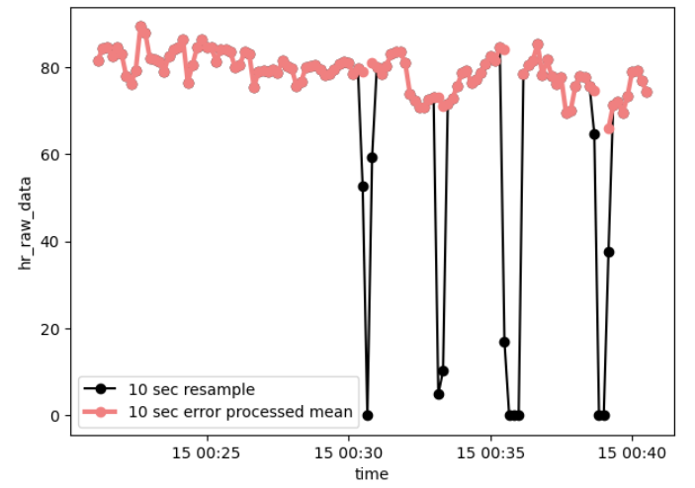
Methodology
Data Preprocessing
Removing Errors
Euclidean distance between each method and the 10 second resampled data
Usual case (When there's few error data)
Error case (When there's a lot of error data)
Error Case – 15% trimmed mean
Error Case – Error processed mean
Euclidean distance | i. Error remove (o) + group mean | ii. Error remove (x) + group trimmed mean
α_wave | 0.003682500000010691 | 0.3134746714525308
hr_raw_data | 0.00000000000000000 | 2.2528755895858237
Euclidean distance | i. Error remove (o) + group mean | ii. Error remove (x) + group trimmed mean
α_wave | 2.100121158689471 | 0.32638866880898937
hr_raw_data | 122.11822529274264 | 19.39874768394027

Slide 18
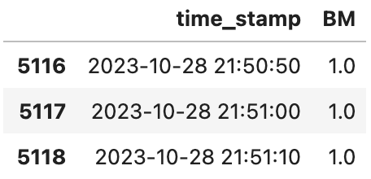
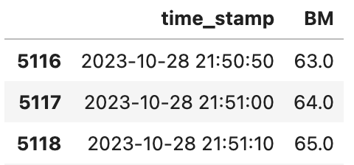
Methodology
Data Preprocessing
Feature Engineering
Body Movement was meaningless because we did our experiment usually while sitting on the chair.
Use accumulated Body Movement value from previous 3 hours
Cognitive functions were improved after an exercise such as: attention, concentration [12].
Time interval | R² score
1 h | 0.83972
1 h 30 m | 0.85472
2 h | 0.86239
2h 30 m | 0.86296
3 h | 0.86428

Slide 19
Methodology
Data Preprocessing
Imputation
The number of data that were removed due to missing values was about 13,000.
Imputation : Fill in the missing value based on the relationship of features
Increase the data size by using the Random Forest Imputation
MSE | Temperature | EDA
Iterative Imputation | 2.8693930001028156 | 24.336120649736955
Random Forest Imputation | 0.017327493178123897 | 0.5766367293404618
K-NN Imputation | 0.19606558047255002 | 144.00392573470927
 | Before Imputation |  | After Imputation
 | Original | Remove Nan value
N or rows | 18,653 | 5,619 | 12,358

Slide 20
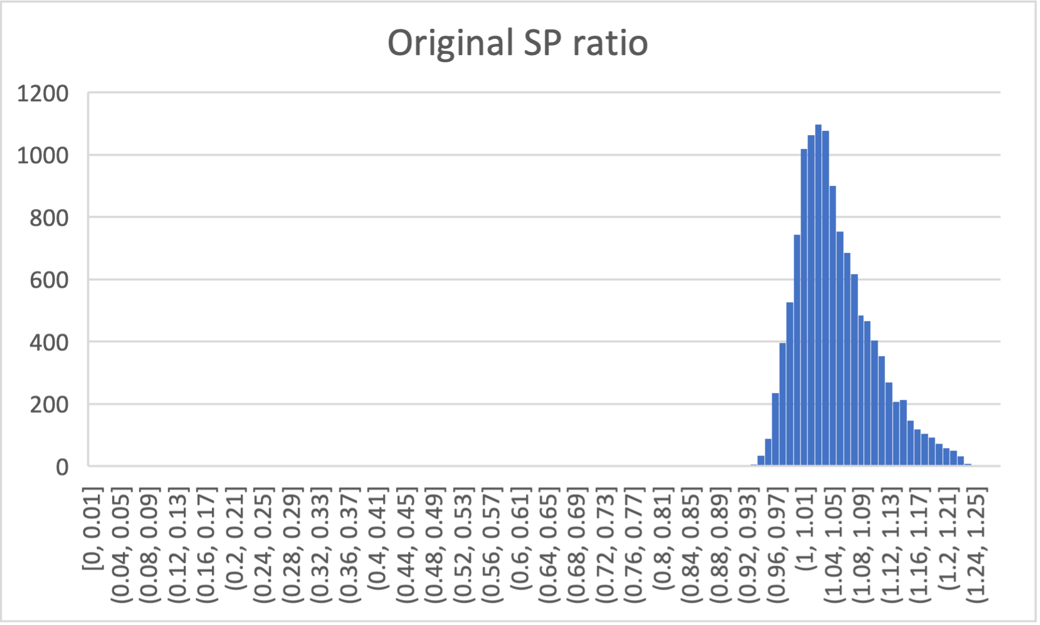
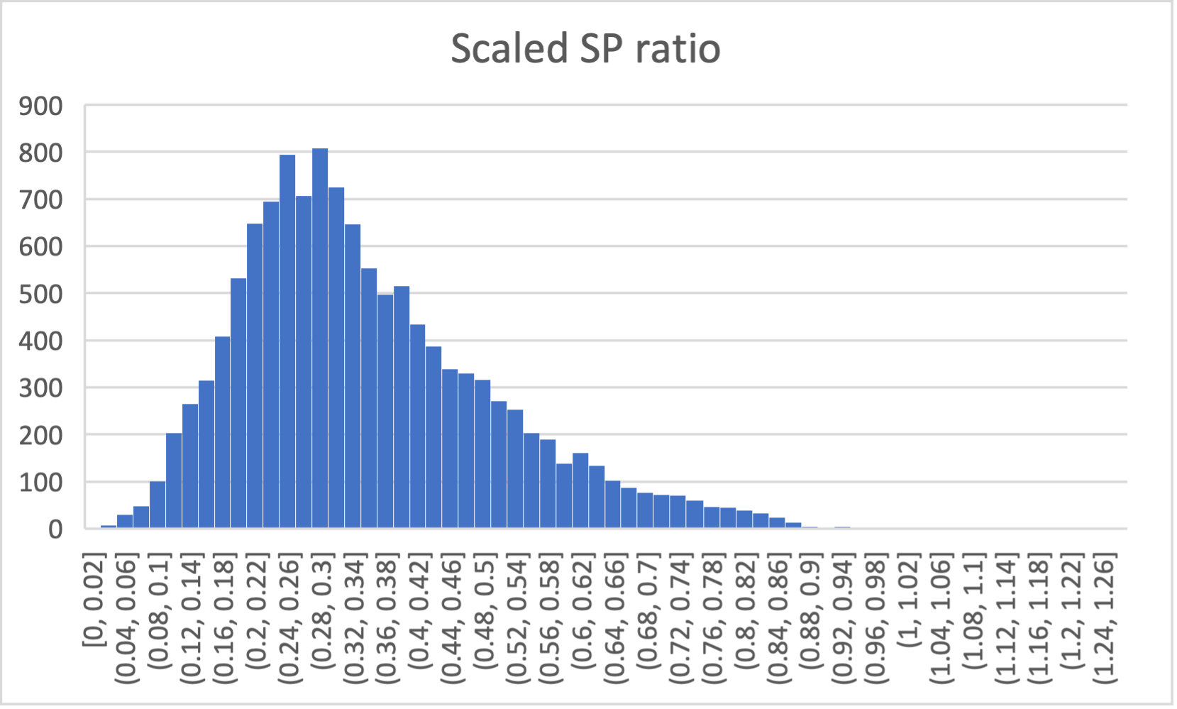
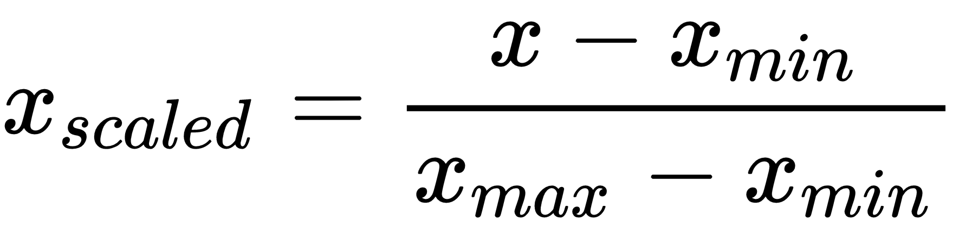
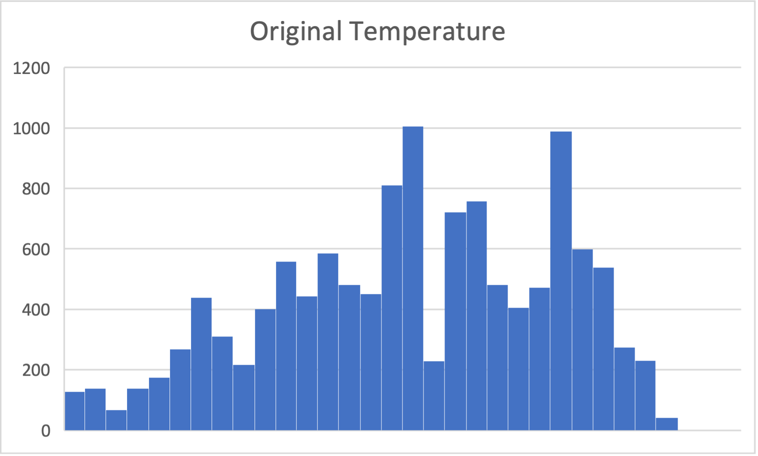
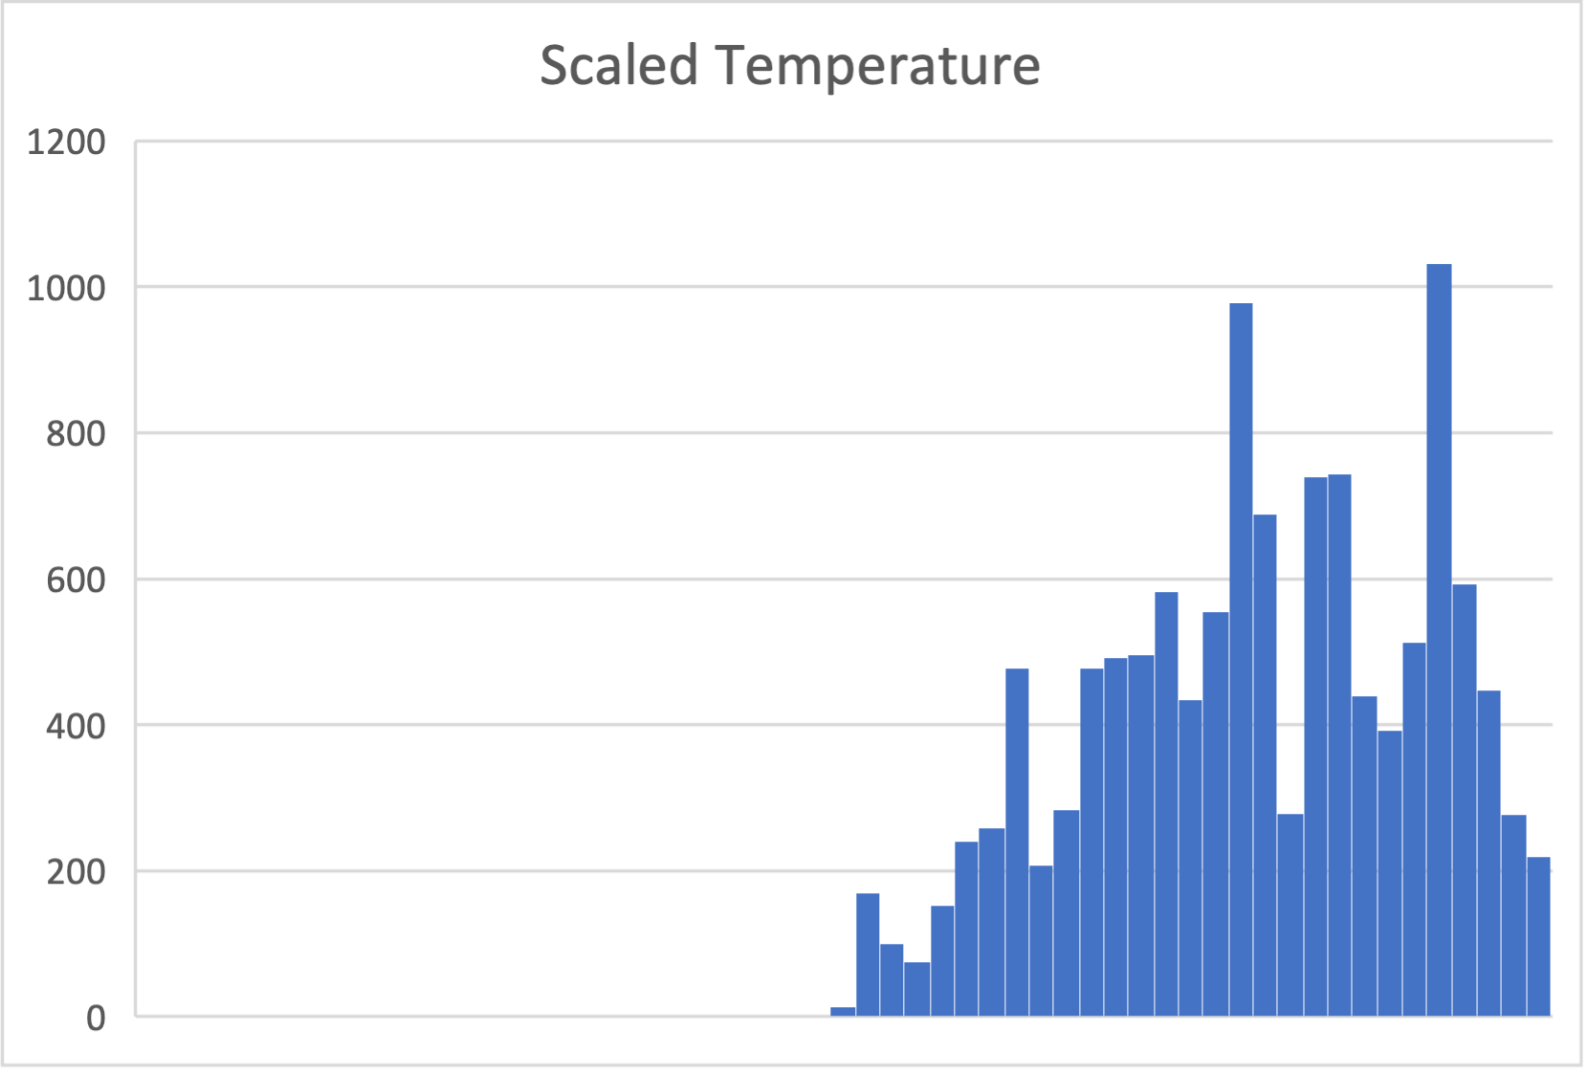
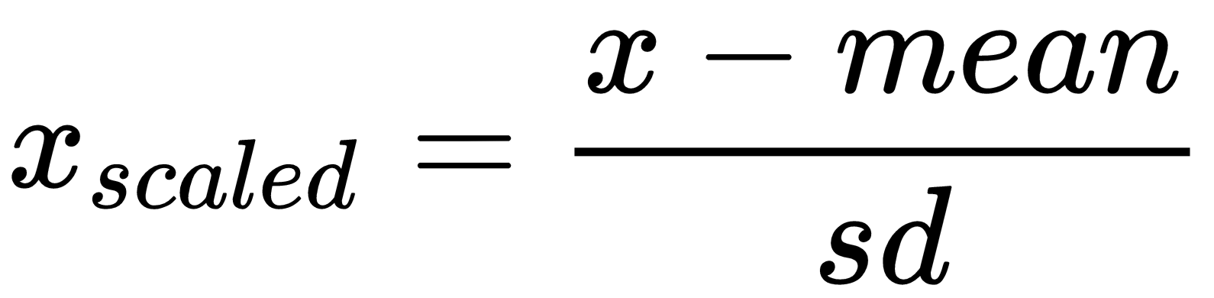
Methodology
Data Preprocessing
Feature Scaling
SP ratio → [0,1]
Temperature : Standardization
Others (hr, hrv, eda) : Normalization

Slide 21
Methodology
Data Preprocessing
Feature Selection
Which combination of features produce the best performance?
Original Dataset : 7 features (HR, HRV, Coherence, BM, Sleep, EDA, Temperature)
Selected Dataset : 6 features (HR, HRV, BM, Sleep, EDA, Temperature)
Feature combination | R² score
hr, hrv, BM, sleep, eda, temperature | 0.8707710654
hr, hrv, coherence, BM, sleep, eda, temperature | 0.8642836913
hr, hrv, BM, eda, temperature | 0.8363532204
hr, hrv, sleep, eda, temperature | 0.8333293457
hr, hrv, coherence, BM, sleep, eda | 0.7995809374
hr, hrv, coherence, BM, sleep, temperature | 0.7995809374

Slide 22
Methodology
Data Preprocessing
R-Squared index
Dataset | N of Row | Extra Tree Regressor | RandomForest Regressor | XGBoost Regressor
(1) Original | 1012 | 0.6208360258 | 0.5751215225 | 0.5425420553
(2) Augmentation | 5763 | 0.8245028924 | 0.7815207115 | 0.7473824518
(3) Removing Errors | 5619 | 0.8081339869 | 0.7860800542 | 0.744537729
(4) Feature Engineering | 5619 | 0.8399870882 | 0.7909246149 | 0.780730066
(5) Imputation | 12358 | 0.8630560284 | 0.8374415757 | 0.796647765
(6) Feature Scaling | 12358 | 0.8642836913 | 0.8342062226 | 0.8029168307
(7) Feature Selection | 12358 | 0.8707710654 | 0.8393843648 | 0.8014808609

Slide 23
Methodology
Model Selection
Models | R² score
Extra Tree Regressor | 0.8583776593
Random Forest Regressor | 0.8267849591
XGBoost Regressor | 0.7900022036
LGBM Regressor | 0.7578767966
KNN Regressor | 0.6992657885
Decision Tree Regressor | 0.6745135311
Gradient Boost Regressor | 0.5505307193
Support Vector Regressor | 0.3748954896
Adaboost Regressor | 0.3341737998
Comparison Conditions
Dataset : preprocessed dataset
k-fold : 5
Train/test split : 0.33
Unoptimized models
Evaluation Metric : R-Squared
Bagging Algorithm
Reduces the correlation between each tree
Bootstrapping sampling
Increases data diversity that makes
reliable outcomes
Notes:
Good good

Slide 24
Methodology
Model Selection
Random Forest Regressor
Multiple decision trees are trained using datasets created through bootstrapping
Learn from a diverse range of data combinations and prevent overfitting
x1
x3
Randomly
2
2
1
1
x1
x2
x3
4
4
1
1
1
1
1
2
2
2
...
Final Predicted Value
3
3
3
4
4
4
x2
x3
3
3
1
1
4
4
4
4
Bootstrapping
Aggregation
Notes:
Good good

Slide 25
Methodology
Model Selection
Extremely Randomized Tree Regressor (Extra Tree Regressor)
Operates almost similarly to the Random Forest Regressor
Difference : Emphasize randomness on the node split part.
x1
x3
Randomly
Randomly
2
2
1
1
x1
x2
x3
4
4
1
1
1
1
1
2
2
2
...
Final Predicted Value
3
3
3
4
4
4
x2
x3
3
3
1
1
4
4
4
4
Bootstrapping
Aggregation
Notes:
Good good

Slide 26
Methodology
Model Selection
XGBoost Regressor
Use gradients to guide the model towards better performance, essentially learning from the errors produced by the previous models.​
Data set
. . . . .
Residuals
Residuals
Residuals
Ensemble
Notes:
Good good

Slide 27
Methodology
Model Training
Optimization (with GridSearchCV)
Explore various combinations of hyperparameters to enhance model performance
Extra Tree Regressor & Random Forest Regressor : Large number of trees
Extra Tree Regressor
Random Forest Regressor
XGBoost Regressor
Hyper parameters | Value
Criterion | ‘squared_error’
n_estimators | 250
max_depth | None
max_feature | 1.0
min_samples_split | 2
Hyper parameters | Value
Criterion | ‘friedman_mse’
n_estimators | 200
max_depth | None
max_feature | 1.0
min_samples_split | 2
Hyper parameters | Value
eval_metric | ‘rmse’
n_estimators | 250
max_depth | 9
Leaning_rate | 0.1
L2 Norm | 1.0
Notes:
Good good

Slide 28

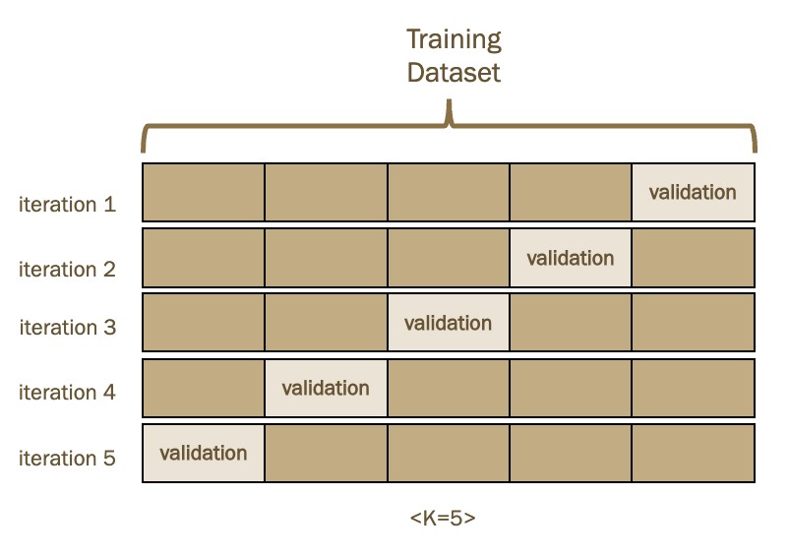
Methodology
Model Training
Improve Model Performance
K-Fold Cross-Validation
Training Dataset
iteration 1
 |  |  |  | validation
 |  |  | validation
K-Fold | dataset | R² score
5 | 6623 | 0.8621270241
10 | 7451 | 0.8738282415
iteration 2
iteration 3
 |  | validation
iteration 4
 | validation
iteration 5
validation
<K=5>
Notes:
Good good

Slide 29
Implementation
Agenda of Implementation
1
Evaluating Models
1
Used Metrics
2
Result
3
Post-processing
2
Developing Application

Slide 30
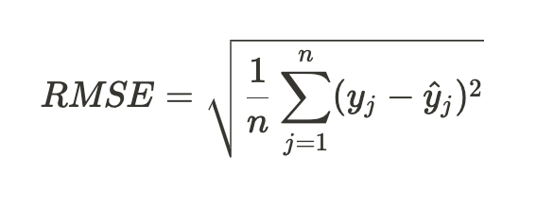
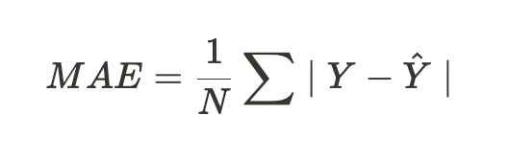
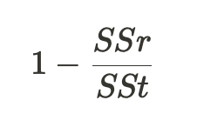
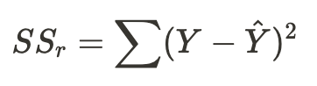
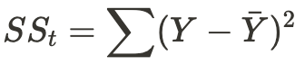
Implementation
Evaluating Models
Used Metrics
Metrics | RMSE (Root Mean Squared Error) | MAE (Mean Absolute Error) | R-Squared (Coefficient of Determination)
Formula
Meaning | Square root of the average of the squared errors for all samples | The average error across all samples | How well the model explains the variability of the dependent variable
Sensitivity for Outliers | high | low | low
Range | [0, ∞] | [0, ∞] | [0,1]
Best score | 0 | 0 | 1
Notes:
Good good

Slide 31
Implementation
Result
Model | k=5 |  |  | k=10
 | R² | MAE | RMSE | R² | MAE | RMSE
ETR | 0.8600028680987881 | 0.060963679571191594 | 0.0902628494555992 | 0.8745109038807887 | 0.05799534323137353 | 0.08545794904910112
Optimized ETR | 0.8610436329928833 | 0.06084093732955484 | 0.08992670809307289 | 0.8763196194533657 | 0.05763151757656443 | 0.08483984698959472
RF | 0.8286250439892058 | 0.06805562983155618 | 0.09986726316728677 | 0.8430348071529264 | 0.06521540785990387 | 0.09557650582699895
Optimized RF | 0.8316705221156353 | 0.06740288263176526 | 0.09897592251857022 | 0.8444204860720559 | 0.06495661215986058 | 0.09515369891812692
XGB | 0.7979545759068449 | 0.07801767052493723 | 0.1084361225403779 | 0.7993313635373537 | 0.07747449387512936 | 0.10806603568024573
Optimized XGB | 0.8270280676352426 | 0.0701333156556275 | 0.10033149620486435 | 0.8314288548822857 | 0.06891060965863388 | 0.09904694590297518
Notes:
Good good

Slide 32
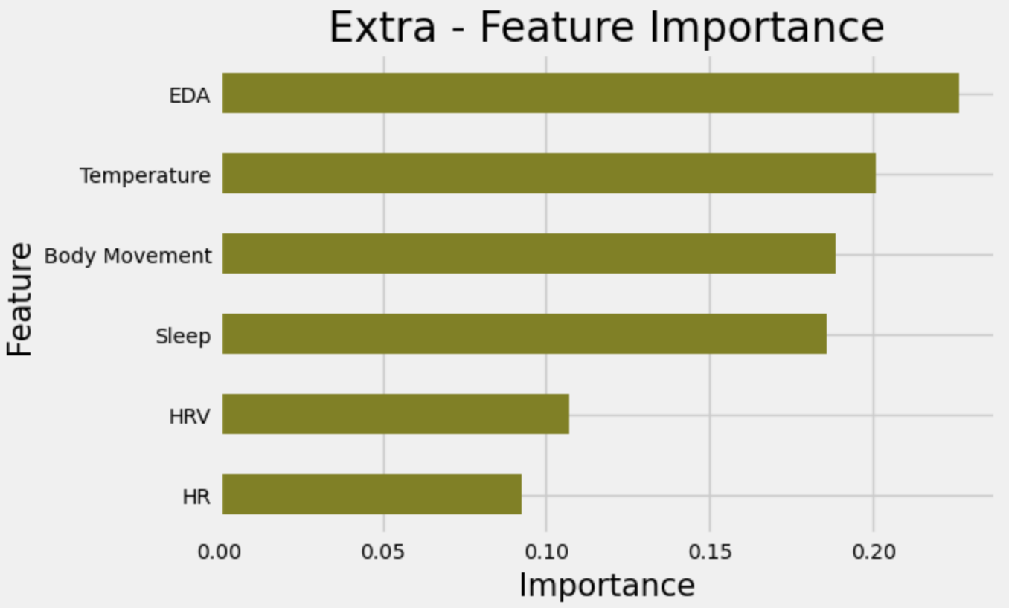
Implementation
Result
Feature Importance
EDA
the highest importance with a score of 0.23
temperature
The second importance with a score of 0.20
Body Movement (0.19)
Sleep (0.19)
HRV (0.11)
HR (0.10)
Feature Importance
0.23
0.20
0.19
0.190
0.11
0.10
Fig. 3. Extra Tree Regressor – Feature Importance
Notes:
Good good

Slide 33
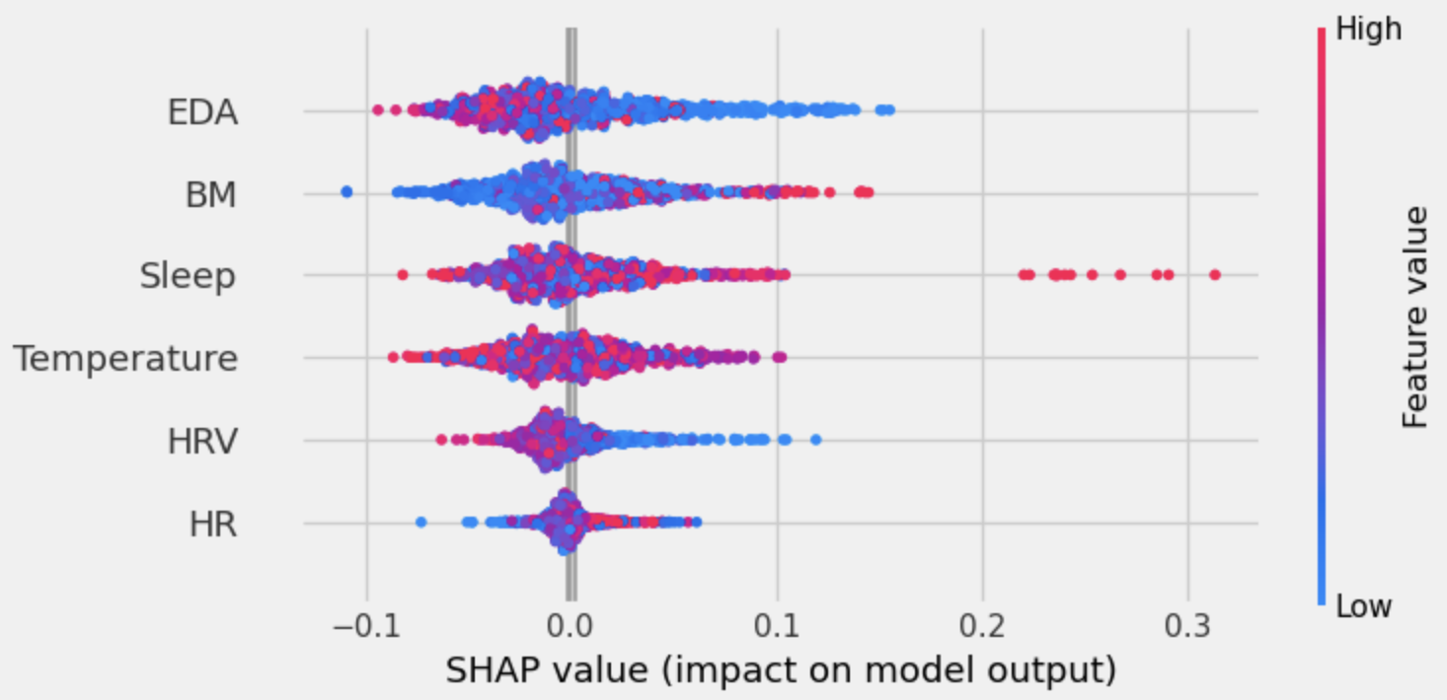
Implementation
Result
SHAP
A tool of Explainable AI
Used to Interpret complex models (Black Box model)
Result
EDA
decrease in EDA leads to higher model prediction.
a negative correlation with concentration.
BM and sleep
contribute to improved model prediction.
a positive correlation with concentration.
SHAP
Fig. 4. Feature Contribution with SHAP
Notes:
Good good

Slide 34
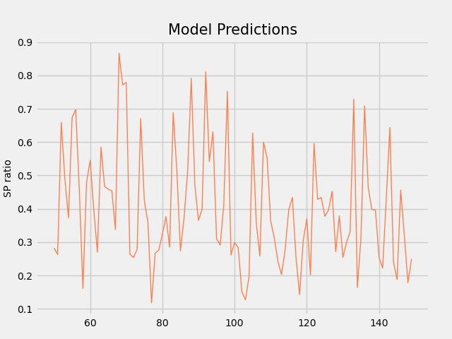
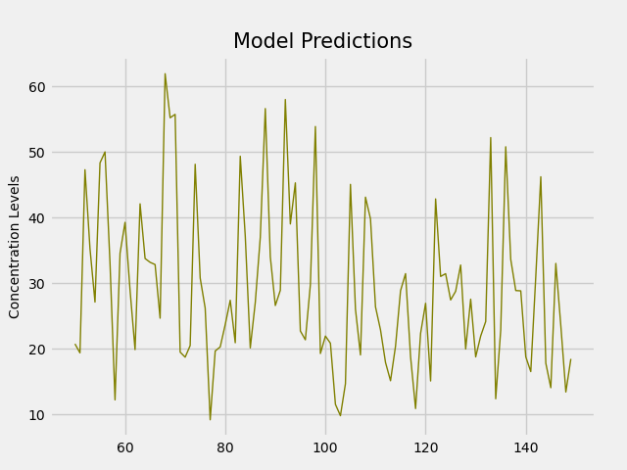
Implementation
Post Processing
Prediction Clipping
scaled range : [0, 1.4] -> [0, 1]
Model Prediction Scaling
scaled range : [0,1] -> [0,100]
Fig. 5. Before-Scaling
Fig. 6. After-Scaling
Notes:
Good good

Slide 35
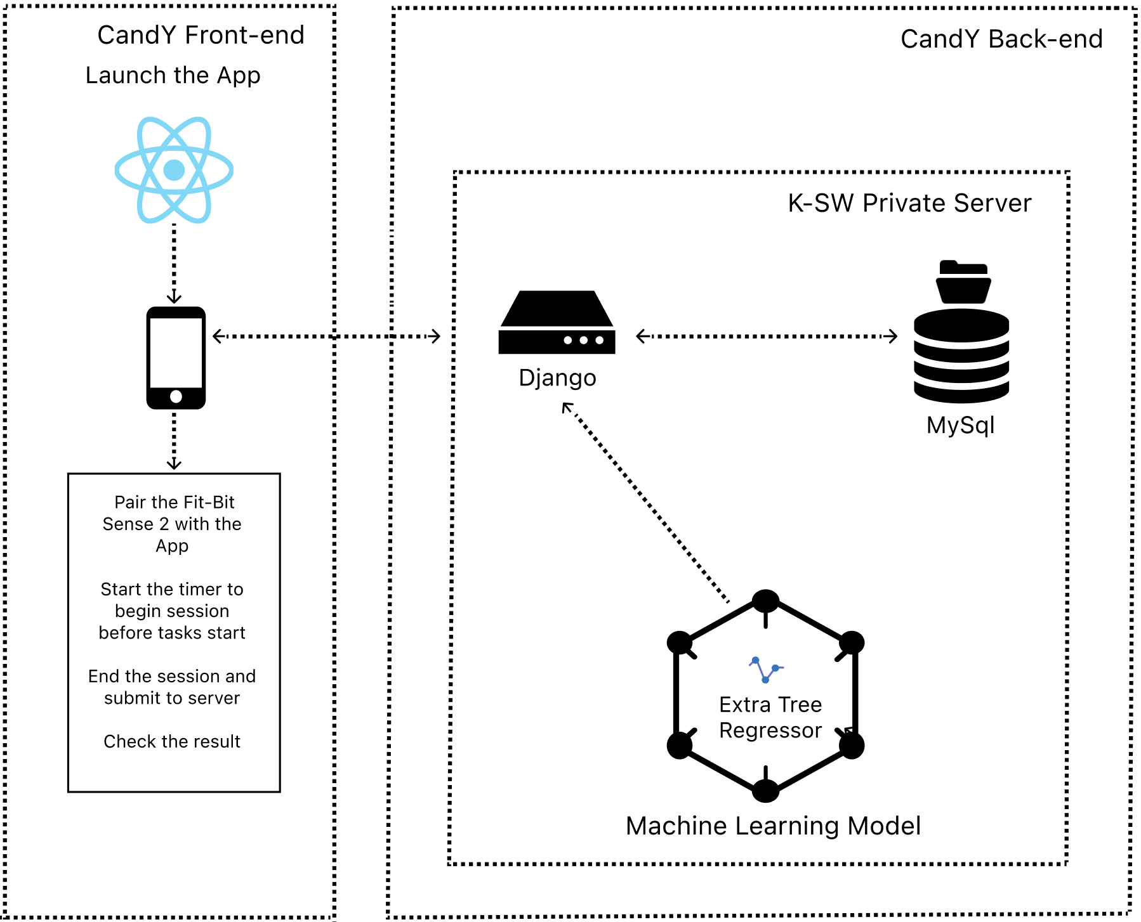
Implementation
System Architecture

Slide 36
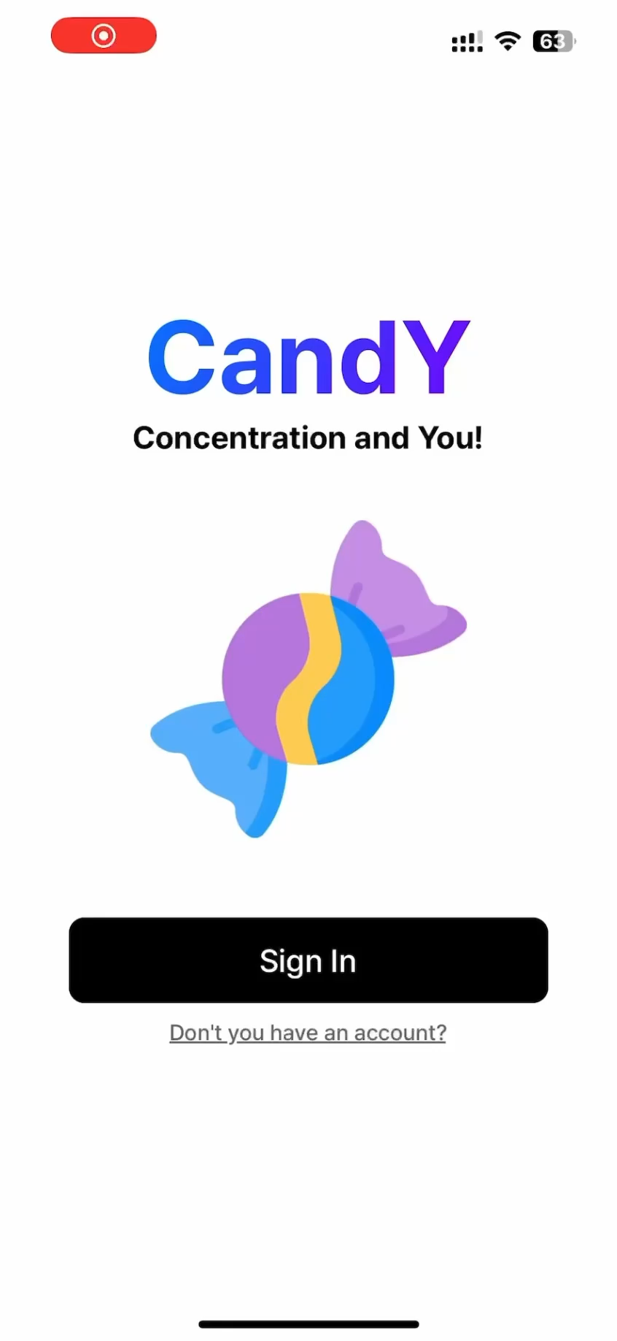
Implementation
System Preview

Slide 37
Conclusion
Machine Learning Models
Model
Extra Tree Regressor
Feature Importance
EDA (Electrodermal Activity) - 0.23
BM (Body Movement) - 0.19
Sleep - 0.19

Slide 38
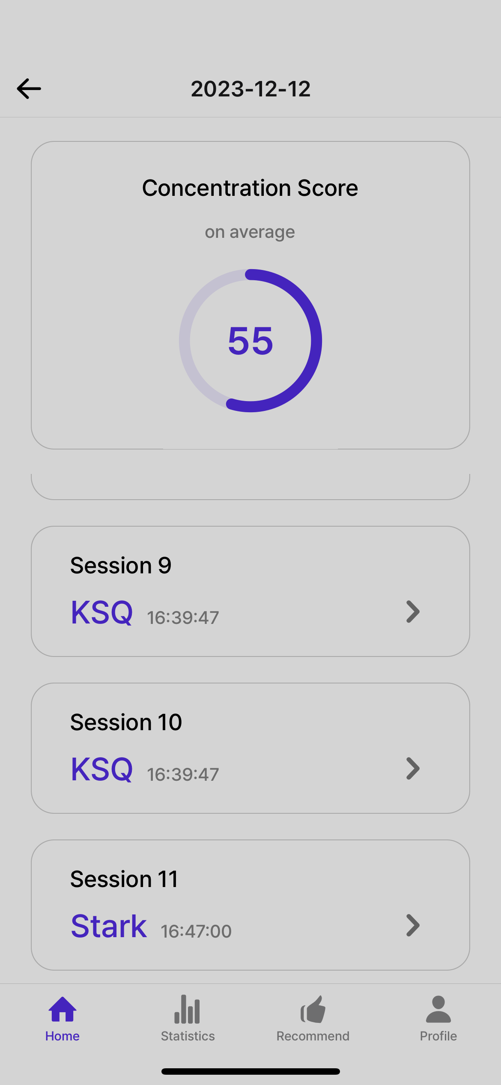
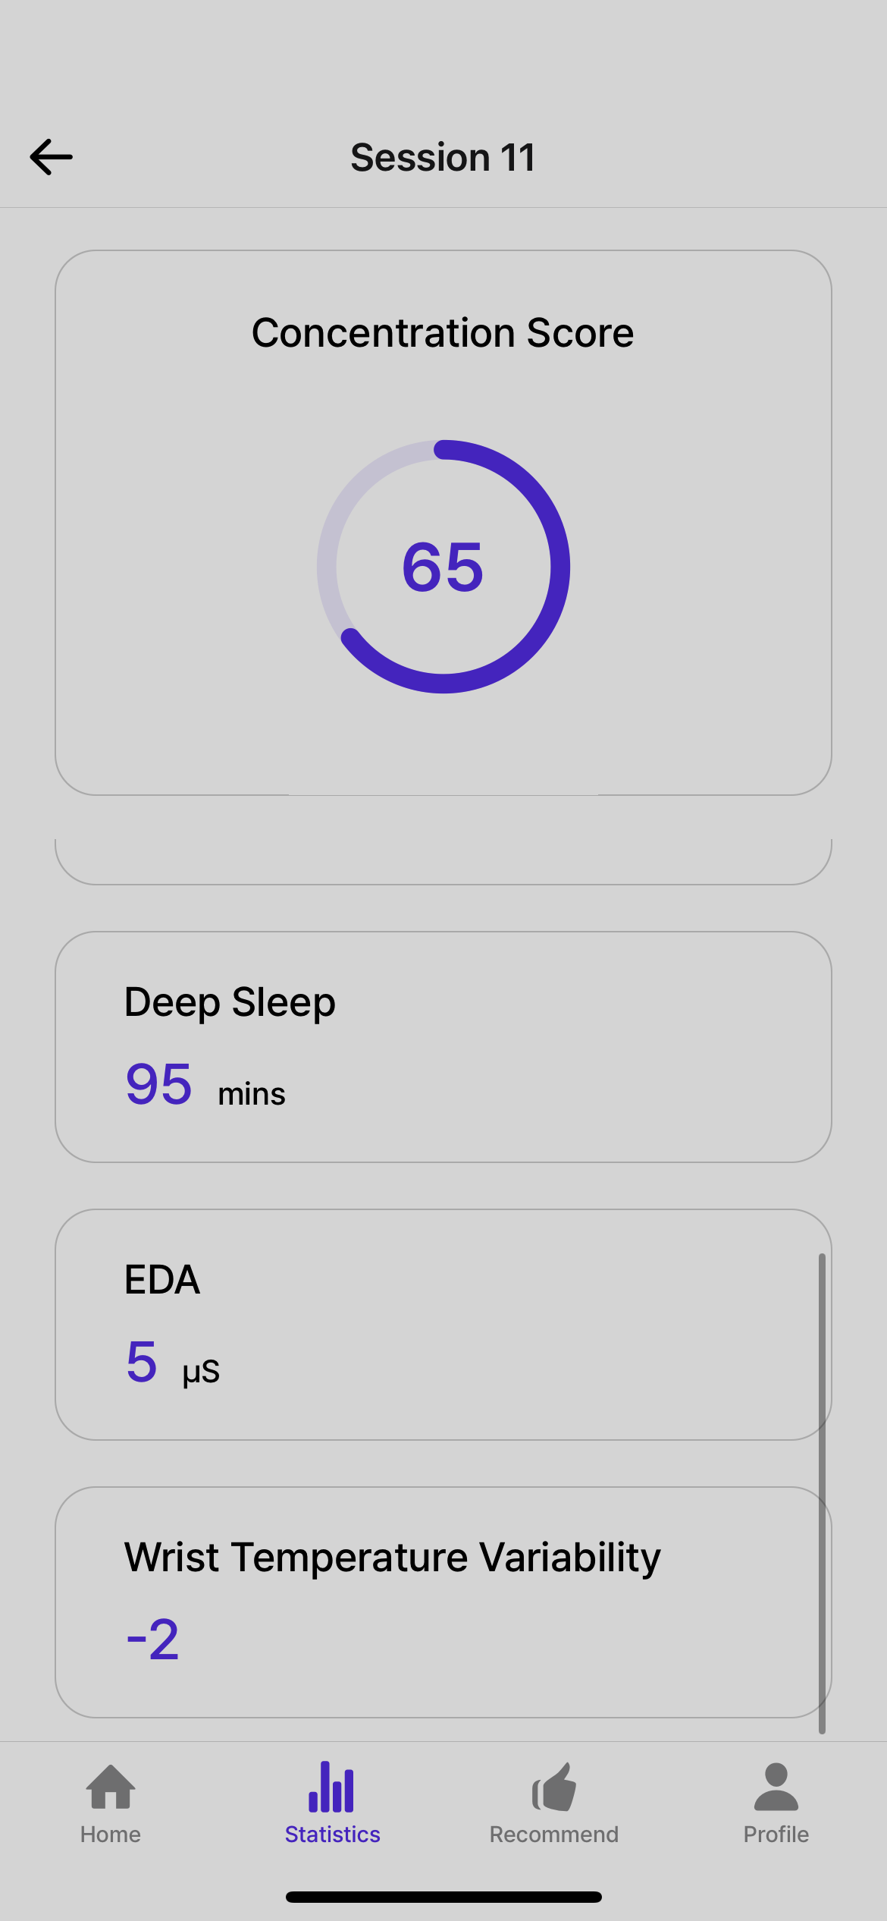

Conclusion
Service
Make the app using the ETR ML model.
Give the user a concentration score from bio-data.
Offer insights for users to enhance their concentration levels.

Slide 39
References
[1] Choi, T. J., Kim, J. O., Jin, S. M., & Yoon, G. (2014).8 Determination of the concentrated state using multiple EEG channels. International Journal of Computer, Electrical, Automation, Control and Information Engineering, 8(8), 1373-1376.
[2] Lokare, V.T., Netak, L.D. (2021). Concentration Level Prediction System for the Students Based on Physiological Measures Using the EEG Device. In: Singh, M., Kang, DK., Lee, JH., Tiwary, U.S., Singh, D., Chung, WY. (eds) Intelligent Human Computer Interaction. IHCI 2020. Lecture Notes in Computer Science(), vol 12615. Springer, Cham. https://doi.org/10.1007/978-3-030-68449-5_3
[3] Liu NH, Chiang CY, Chu HC. Recognizing the degree of human attention using EEG signals from mobile sensors. Sensors (Basel). 2013 Aug 9;13(8):10273-86. doi: 10.3390/s130810273. PMID: 23939584; PMCID: PMC3812603.
[4] C. Hasegawa and K. Oguri, "The effects of specific musical stimuli on driver~s drowsiness," 2006 IEEE Intelligent Transportation Systems Conference, Toronto, ON, Canada, 2006, pp. 817-822, doi: 10.1109/ITSC.2006.1706844.
[5] Lutsyuk, N.V., Éismont, E.V. & Pavlenko, V.B. Modulation of attention in healthy children using a course of EEG-feedback sessions. Neurophysiology 38, 389–395 (2006). https://doi.org/10.1007/s11062-006-0076-0
[6] Kwon JW, Sung S, Lee SB, Lee HM, Moon SH, Lee BH. Intraoperative real-time stress in degenerative lumbar spine surgery: simultaneous analysis of electroencephalography signals and heart rate variability: a pilot study. Spine J. 2020 Aug;20(8):1203-1210. doi: 10.1016/j.spinee.2020.02.006. Epub 2020 Feb 14. PMID: 32061939.
[7] Martínez Vásquez DA, Posada-Quintero HF, Rivera Pinzón DM. Mutual Information between EDA and EEG in Multiple Cognitive Tasks and Sleep Deprivation Conditions. Behavioral Sciences. 2023; 13(9):707. https://doi.org/10.3390/bs13090707
Notes:
[8] Kim SC, Lee MH, Jang C, Kwon JW, Park JW. The effect of alpha rhythm sleep on EEG activity and individuals' attention. J Phys Ther Sci. 2013 Dec;25(12):1515-8. doi: 10.1589/jpts.25.1515. Epub 2014 Jan 8. PMID: 24409009; PMCID: PMC3885828.
[9] Alba G, Vila J, Rey B, Montoya P, Muñoz MÁ. The Relationship Between Heart Rate Variability and Electroencephalography Functional Connectivity Variability Is Associated With Cognitive Flexibility. Front Hum Neurosci. 2019 Feb 25;13:64. doi: 10.3389/fnhum.2019.00064. PMID: 30858800; PMCID: PMC6397840.
[10] [Aminosharieh Najafi, T., Affanni, A., Rinaldo, R., & Zontone, P. (2023). Driver Attention Assessment Using Physiological Measures from EEG, ECG, and EDA Signals. Sensors, 23(4), 2039, 2-2. https://doi.org/10.3390/s23042039]
[11] Aminosharieh Najafi T, Affanni A, Rinaldo R, Zontone P. Driver Attention Assessment Using Physiological Measures from EEG, ECG, and EDA Signals. Sensors. 2023; 23(4):2039. https://doi.org/10.3390/s23042039

Slide 40
References
[8] Kim SC, Lee MH, Jang C, Kwon JW, Park JW. The effect of alpha rhythm sleep on EEG activity and individuals' attention. J Phys Ther Sci. 2013 Dec;25(12):1515-8. doi: 10.1589/jpts.25.1515. Epub 2014 Jan 8. PMID: 24409009; PMCID: PMC3885828.
[9] Alba G, Vila J, Rey B, Montoya P, Muñoz MÁ. The Relationship Between Heart Rate Variability and Electroencephalography Functional Connectivity Variability Is Associated With Cognitive Flexibility. Front Hum Neurosci. 2019 Feb 25;13:64. doi: 10.3389/fnhum.2019.00064. PMID: 30858800; PMCID: PMC6397840.
[10] [Aminosharieh Najafi, T., Affanni, A., Rinaldo, R., & Zontone, P. (2023). Driver Attention Assessment Using Physiological Measures from EEG, ECG, and EDA Signals. Sensors, 23(4), 2039, 2-2. https://doi.org/10.3390/s23042039]
[11] Hans P.A. Van Dongen, Greg Maislin, Janet M. Mullington, David F. Dinges, The Cumulative Cost of Additional Wakefulness: Dose-Response Effects on Neurobehavioral Functions and Sleep Physiology From Chronic Sleep Restriction and Total Sleep Deprivation, Sleep, Volume 26, Issue 2, March 2003, Pages 117–126
[12] Peter Blomstrand, Jan Engvall, Effects of a single exercise workout on memory and learning functions in young adults – A systematic review. Translational Sports Medicine published by John Wiley & Sons Ltd. 2020;00: 1-13.
Notes:
[8] Kim SC, Lee MH, Jang C, Kwon JW, Park JW. The effect of alpha rhythm sleep on EEG activity and individuals' attention. J Phys Ther Sci. 2013 Dec;25(12):1515-8. doi: 10.1589/jpts.25.1515. Epub 2014 Jan 8. PMID: 24409009; PMCID: PMC3885828.
[9] Alba G, Vila J, Rey B, Montoya P, Muñoz MÁ. The Relationship Between Heart Rate Variability and Electroencephalography Functional Connectivity Variability Is Associated With Cognitive Flexibility. Front Hum Neurosci. 2019 Feb 25;13:64. doi: 10.3389/fnhum.2019.00064. PMID: 30858800; PMCID: PMC6397840.
[10] [Aminosharieh Najafi, T., Affanni, A., Rinaldo, R., & Zontone, P. (2023). Driver Attention Assessment Using Physiological Measures from EEG, ECG, and EDA Signals. Sensors, 23(4), 2039, 2-2. https://doi.org/10.3390/s23042039]
[11] Aminosharieh Najafi T, Affanni A, Rinaldo R, Zontone P. Driver Attention Assessment Using Physiological Measures from EEG, ECG, and EDA Signals. Sensors. 2023; 23(4):2039. https://doi.org/10.3390/s23042039

Slide 41
Q& A

Slide 42
Thank you
Team HoT
Byeongsoo Min, Jeongmin Seo, Seojeong Park, Seungah Jang, Yunhui Lim, and
Martin Kim

Slide 43
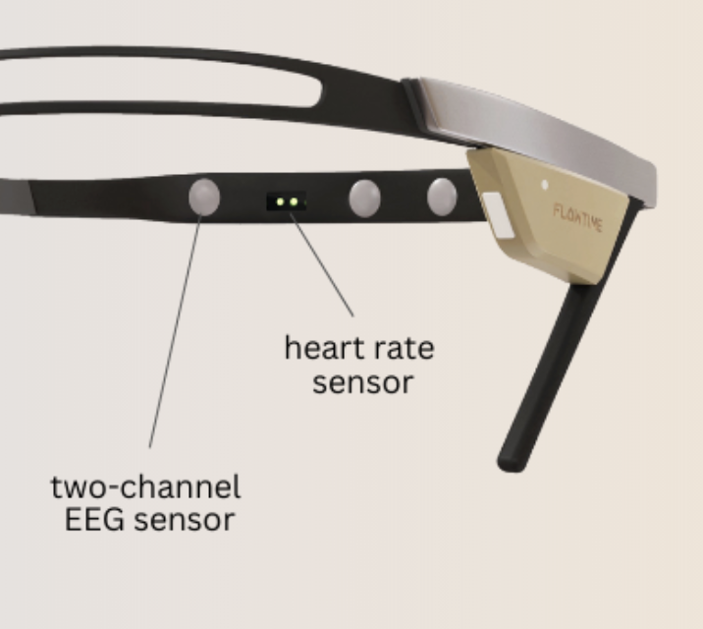
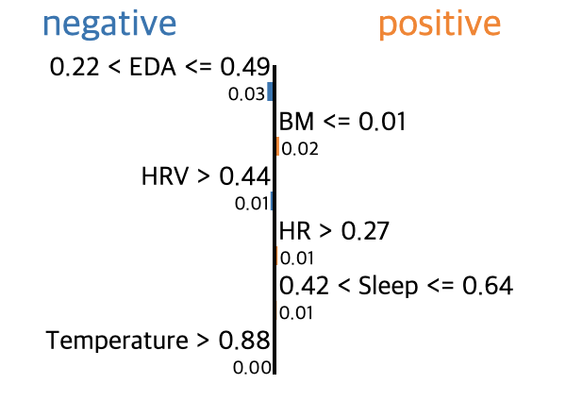
Additional Material
LIME
Fig. 2. Diagrams of the power of the EEG rhythms [5]
Notes:
Good good

